Slide 1


Wydział Elektroniki
Introduction Days at WUT
Meeting with Faculty Coordinators
Dr Dariusz CABAN, ERASMUS Coordinator
Prof. Piotr SŁOBODZIAN, ERASMUS Coordinator
Ms. Anna KOLMAN, Head of the International Team Office
Faculty of Electronics
Wroclaw, 2018

Slide 2
Contents
1.The Faculty of Electronics
2.Who will take care of you – persons responsible
3.Student’s ID at WrUST
4.Your curriculum
a)the academic calendar
b)enrolment on courses
c)receiving final credits

Slide 3
The Faculty of Electronics
The faculty in numbers
over 60-year experience in education and research
the biggest faculty in Poland (for ICT and CE&R)
Fields of study:
–Control Engineering and Robotics
–Electronics
–Telecommunications
–Informatics
–Teleinformatics
- Electronic and Computer Engineering (1st level of studies, in English)
- Cybersecurity ( 1st level of studies, in Polish)
over 6.000 students
teaching staff: ca. 200 persons (36 professors)
More info at: http://weka.pwr.edu.pl/o-wydziale/o-nas/materialy-informacyjne

Slide 4
Laboratories

Slide 5
The Faculty of Electronics
Where we are - the city map

Slide 6
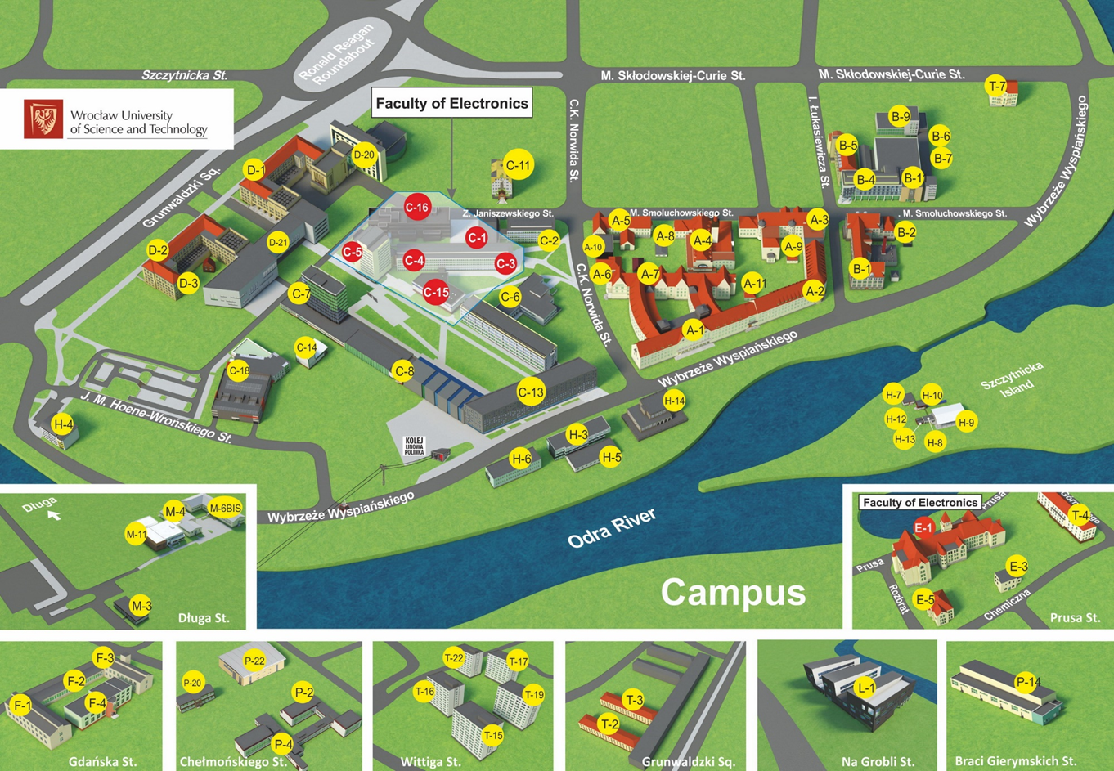
The Faculty of Electronics

Slide 7
Who will take care of you …
Persons responsible at the faculty
First coordinator
Second coordinator
Assistant
Dr Dariusz CABAN
room 226
building C-3
dariusz.caban@pwr.wroc.pl
Responsibility area:
- informatics
- control
Prof. Piotr SŁOBODZIAN
room 808
building C-5
piotr.slobodzian@pwr.wroc.pl
Responsibility area:
- telecommunications
- electronics
Ms. Anna KOLMAN
room 108
building C-5
and …. the International Office

Slide 8
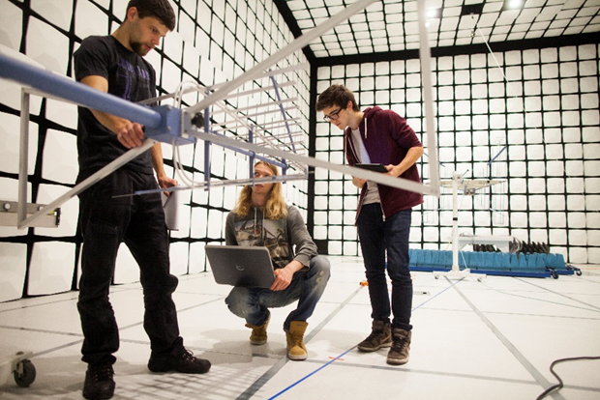
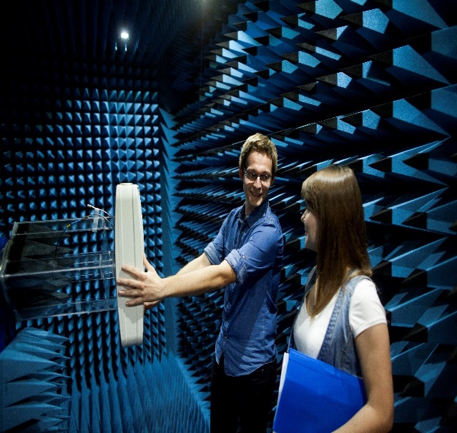
Student’s ID at WrUST
ID number
  required for various purposes at WUT:
    the enrolment on courses
    library
    access to the information system
      EDUKACJA.CL
      JSOS
      Bartosz Staszczak office ( 12 C-3)
ID card
  certify your ID number and your identity
  give you a discount on acces to:
    public city transport (50%)
    cinema, theatre, museums etc.
    other events
      where to receive: at Ms. Kolman’s office
    Web page access to EDUKACJA.CL
    https://rekrutacja.pwr.wroc.pl/EdukacjaWeb/

Slide 9
Courses
The academic calendar - more info at: http://pwr.edu.pl/studenci/kalendarz-akademicki
ACADEMIC YEAR 2017/18
Summer semester– 15 weeks

Slide 10
Course attendence
Subjects and Courses
  the particular subjects are taught within units called courses or groups of courses
  a course is understood to be teaching periods conducted within a single semester, in the form of: the lecture, classes, the seminar, laboratory classes, project classes, student vocational training, the engineering project or the diploma dissertation
  a group of courses is understood to be all or selected courses on a given subject, done within one and the same semester
Example
Form
Edukacja.CL
Course
the lecture
Main mark
+
Final mark
Digital Circuits
classes
and ECTS
if pass
2 additional marks
laboratory classes

Slide 11
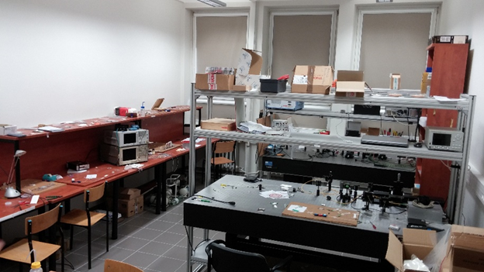
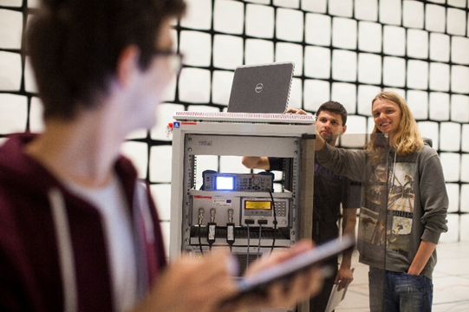
Enrolment
Enrolment on courses
  course selection: from the list of courses delivered in English
  courses in Polish must be approved by the course supervisor and the ERASMUS Coordinator
  you must enroll to all forms of a course !!!
  after gathering a list of courses go to ANNA KOLMAN Important dates for the enrolment
  start: as soon as you know your student ID

Slide 12
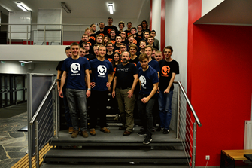
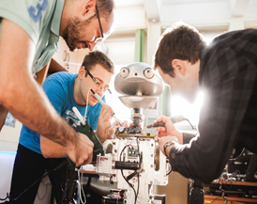
Access to Edukacja CL and JSOS
EdukacjaCL provides record on courses you have registered to and on the timetable
JSOS provides record on the final marks given by the teachers
Access to the system is obtained on the basis of a login/password
  Received by email
  Requires contact with Bartosz Staszczak in the Dean’s Office Computer Section (12 C-3)
This will also provide you with PWR email address (required by some Supervisors)

Slide 13
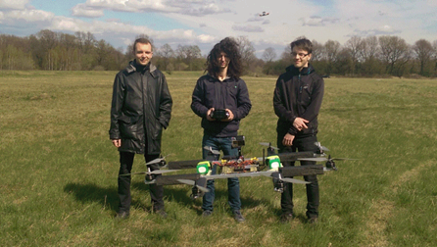
Transcript of records
Gathering final marks
Each student must have an access to JSOS (the name of the user and password are the same as to Edukacja)
An acces to JSOS is necesarry to accept or bring a complaint regarding the notes
  At the end of semester (or two semesters) each student will receive a transcript of records (dr CABAN) and a confirmation of his stay period at WrUST (International Office)
  Until the notes are not accepted, we can not prepare a transcript of records

Slide 14

Introduction Days at WrUST
Thank you for your attention
and
good luck in your studies !

