Slide 1
Faculty of Electronics
Introduction Days for International Students
19th February 2018

Slide 2
Faculty of Electronics (W-4)
The biggest faculty of Information and Communication Technologies in Poland. The faculty also includs Control Engineering and Robotics, General Electronics and Acoustics. The faculty has over 60 year experience in education and scientific research.
Historical building - Prusa street, Wrocław

Slide 3
The Faculty of Electronics
See, buildings: C1, C3, C4, C5, C16 and C15 (EMC Lab.)

Slide 4
Plan of the meeting
Presentation of the authorities and the administrative structure of the Faculty of Electronics
The Matriculation
Basic information about classes (curriculum, didactics, etc.)
Student’s affairs

Slide 5
Structure of the University - Faculties Wrocław University of Science and Technology
Rektor (President) of the Wrocław University of Science and Technology
prof. dr hab. inż. Cezary Madryas
Faculty of Architecture (W1)
Faculty of Civil Engineering (W2)
Faculty of Chemistry(W3)
Faculty of Electronics(W4)
Faculty of Electrical Engineering (W5)
Faculty of Geoengineering, Mining and Geology(W6)
Faculty of Environmental Engineering (W7)
Faculty of Computer Science and Mangement(W8)
Faculty of Mechanical and Power Engineering (W9)
Faculty of Mechanical Engineering (W10)
Faculty of Fundamental Problems of Technology(W11)
Faculty of Microsystem Elctronics and Photonics (W12)
Faculty of Pure and Applied Mathematics (W13)
Faculty of Technology and Natural Science (W14) in Legnica
Faculty of Technology and Computer Science(W15) in Jelenia Góra
Faculty of Technology and Engineering (W16) w Wałbrzychu

Slide 6
The Authorities and the structure of the Faculty of Electronics www.weka.pwr.edu.pl

Slide 7
The Authorities
Vice-Dean for Bachelor,Master Studies and Students Affair
Zbigniew Zajda, Ph.D.Eng.
DEAN
Prof. Czesław Smutnicki, Ph.D.D.Sc.Eng.
Vice-Dean for Bachelor, Master Studies, Admission, Marketing and Promotion
Adam Wąż, Ph.D.Eng.
Vice-Dean for Faculty Finance and International Cooperation Ryszard Zieliński, Ph.D.D.Sc.Eng., WrUST Assoc.Prof.
Vice-Dean for Extramural Studies and Internship
Stefan Brachmański, Ph.D. Eng.
Vice–Dean for Master Studies, Plans and Programmes of Study
Leszek Koszałka, Ph.D.Eng.

Slide 8
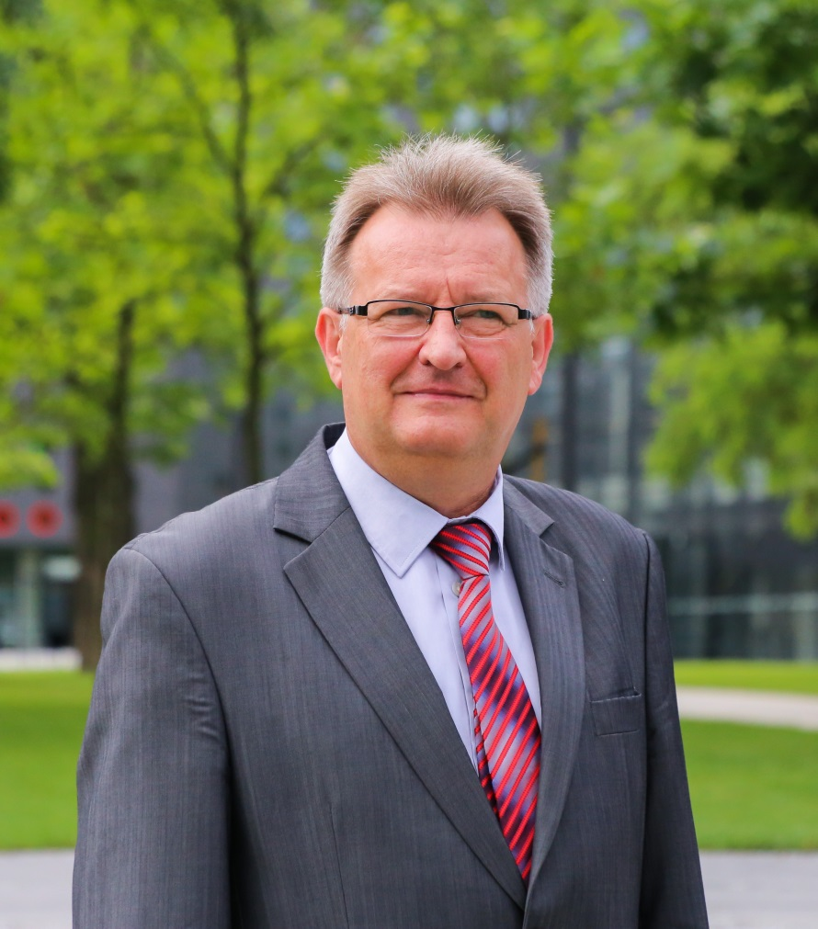
The Dean
Prof.
Czesław Smutnicki Ph.D.D.SC.Eng.

Slide 9
Departments at the Faculty of Electronics
Department of Electronic and Photonic K-1, prof. Janusz Mroczka
Department of Systems and Computer Networks K-2, prof. Andrzej Kasprzak
Department of Telecommunications and Teleinformatics K-3, prof. Tadeusz Więckowski
Department of Field Theory, Electronics Circuits and Optoelectronics K-4, prof. Krzysztof Abramski
Department of Acoustic and Multimedia K-5, prof. inż. Andrzej Dobrucki
Department of Signal Processing Systems K-6, prof. Jan Zarzycki
Department of Cybernetics and Robotics K-7, Prof. Alicja Mazur
Department of Control Systems and Mechatronics
K-8, Prof. Ewaryst Rafajłowicz
Department of Computer Engineering
K-9, Prof. Czesław Smutnicki - The Dean

Slide 10
The act of oath-taking
Upon acceptance to Wrocław University of Science and Technology, I ….. , do solemnly declare to:
persistently pursue knowledge
develope my mind and character while contributing creatively to the community
uphold the rules and traditions of the University
maintain the standard of excellence of the Wrocław University of Science and Technology

Slide 11
The Dean Office – room 102A, C-2
Manager : Agnieszka Gawryszuk, MSc, Eng.
Officers for full-cycle study students (name first letter / stand): Joanna Kawecka (No.5) Józefa Żyto (No.6)
Paweł Mioduszewski (No.7)
Officer for internships and suplements (stand No.3): Piotr Wójcik
Officer for part-time study students (stand No.4): Teresa Jończyk
Officer for alumnies (stand No. 2): Beata Ocha
Officer for PhD students & accounting department (stand No.8): Agnieszka Chaszczewska
Department of Informatization - room 12, C-3
Arkadiusz Misiewicz, MSc, Eng. – the manager The team: Magdalena Motowidełko, Daria Piwko, Bartosz Staszczak

Slide 12
Study at the Faculty of Electronics
First level study – Bachelor’s degree program
Semesters:
1 | 2 | 3 | 4 | 5 | Choice of specialization | 6 | 7 | Bachelor
Second level study – Master’s degree program
Semesters:
1 | Choice of specialization | 2 | 3 | Master
Third level study – PhD program
4 years

Slide 13
Plan of the study – Master program
h\sem. | I semester | II semester | III semester
23 |  |  | Courses for Specialization
22 | Courses for the field of study | Courses for Specialization
21
20
19
18
17
16
15
14 |  |  | Entrepreneurship 10001 ZMZ0387
13
12 |  |  | Master Thesis (final project)
11
10
9
8
7 | Social com. 00001 FLEU001
6 | Physics 10000 FZP4901
5 | Mat. 10000 MAP3032
4 | Foreign language lev. B2+ 01000
3 | Forein language at lev. A1 03000
2 |  | Seminar for Specialization | Diploma Seminar
1

Slide 14
Plan of study – bachelor program

Slide 15
Plan of study – bachelor program
Refers to previous slide
Dark grey cells – general courses
Light grey cells – courses for the field of study
Light cells – optional courses

Slide 16
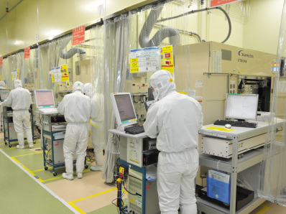
Fields of study
AAE - Advanced Applied Electronics ( master)

Slide 17
Fields of study
TMT - Modern Telecommunications ( master)

Slide 18
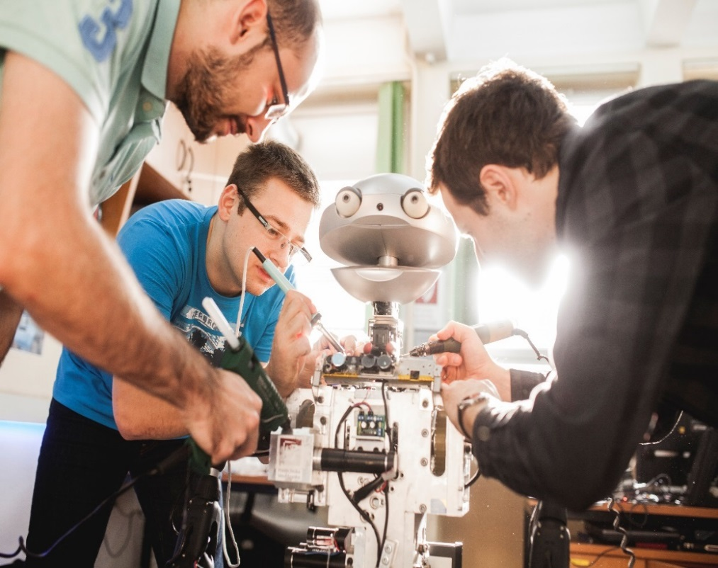
Fields of study
ARE – Embedded Robotics ( master)

Slide 19
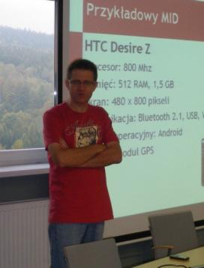
Fields of study
INE – Internet Engineering ( master)

Slide 20
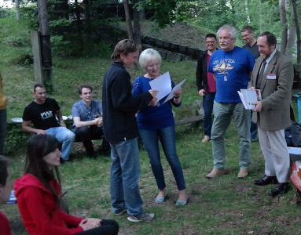
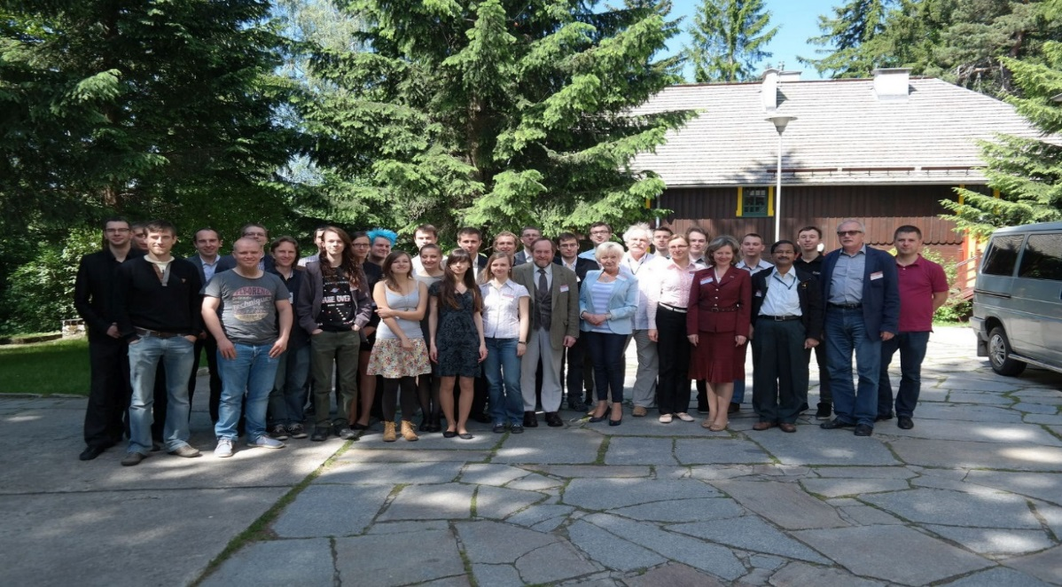
Fields of study
AIC – Advanced Informatics and Control ( master)

Slide 21
Studies in English ( Bachelor studies)
Electronic and Computer Engineering
The first admission took place in academic year 2016/17
This course will give students multidisciplinary knowledge
of electronics and computer engineering. It will enable
them to obtain theoretical and practical knowledge in
designing applied electronic systems based on analogue
and digital techniques as well as gaining expertise in microprocessors,
programmable logic applications and signal
processing. Graduate students will be able continue
second level study in the fields of Electrical Engineering,
Computer Science, Automation and Robotics or Telecommunication,
or other related fields.

Slide 22
Teaching Organization Office manager: Agnieszka Misiewicz, MSc responsible for preparing plans of studies, rooms reservation, attending to the e-mail box „zapisy_W4” International Office manager: Anna Kolman, MSc responsible for departure of foreign students, Erasmus+, Erasmus Mundus, International Exchange For more information go to: www.weka.pwr.edu.pl
Organization of teaching

Slide 23
Organization of teaching
Only for the first week of semester
26.02. – 02.03.2018
tydzień Nieparzysty
Odd week
Example in a timetable
MAP003031W D1.2 (C-16) Statystyka
matematyczna
First hour of the block
FZP04901W
322 (A-1)
Fizyka
Second hour of the block
tydzień Parzysty
Even week

Slide 24
Organization of teaching
ECTS
Learning outcomes
Groups of courses
90 ECTS points

Slide 25
Enrollment
Each student must be enrolled on courses by means of Edukacja.CL system individually.
The enrolment must be finished at the beginning of semester (according to the approved schedule and financial regulations).
The student can not attend and pass any course without enrolment first.
The student that had enrolled on a course and than have never showed up on that course cannot get credit for that course.
A course can be canceled but the cancelation must be well-founded (e.g. long-lasting illness).
The second and further undertaking of a course is allowed but it is payable
The fourth realization of the course – consent of the Dean is required
The fifth realization of the course – consent of the Dean is required

Slide 26
Acceptable deficit in ECTS points
After I semester - 8 ECTS points
After II semester - 8 ECTS points

Slide 27
Some regulations governing Higher Education Studies at WrUST
Long term leave – granted for the whole semester (§18):
leave for health reason (written confirmation of a clinic)
parental leave (written confirmation of Registry Office)
vocational leave (granted for internship within an international program initiated by WrUST with foreign companies and universities)
Dean’s leave (in the case the allowable limit of deficit points is exceeded after the semester, in accordance with the schedule approved by the Faculty Council. A student may be given one semester Dean’s leave twice during his master study)

Slide 28
Some regulations governing Higher Education Studies at WrUST
Short term leave – lasting no longer than 10 days (§18) only one in semester:
Sick leave (written confirmation of a sick)
Sabbatical leave (written permission of a supervisor of the diploma thesis or an academic teacher with the title of professor or the academic degree of associate professor - dr hab., appointed by the Dean)

Slide 29
Some regulations governing Higher Education Studies at WrUST
Short term leave are not granted during the last 7 days of the semester when classes are still running and during the examination session
Short term absence from classes, caused by objective reasons, unavoidable and unpredictable ( short period of illness, exceptional occurrence) are excused directly by the teacher after the student provided satisfactory explanation
Short tem leave + short term absence – can not exceed 10 working days in a semester

Slide 30
The right to register for the next semester
A student has the right to register for the next semester without notification to the Dean’s Office if he has made required payments for education services and has received positive grades only
A student with point deficit exceeding the acceptable level may apply for Dean’s leave for the next semester

Slide 31
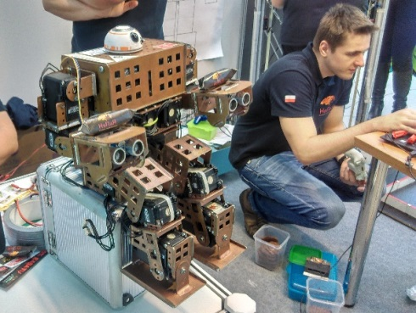
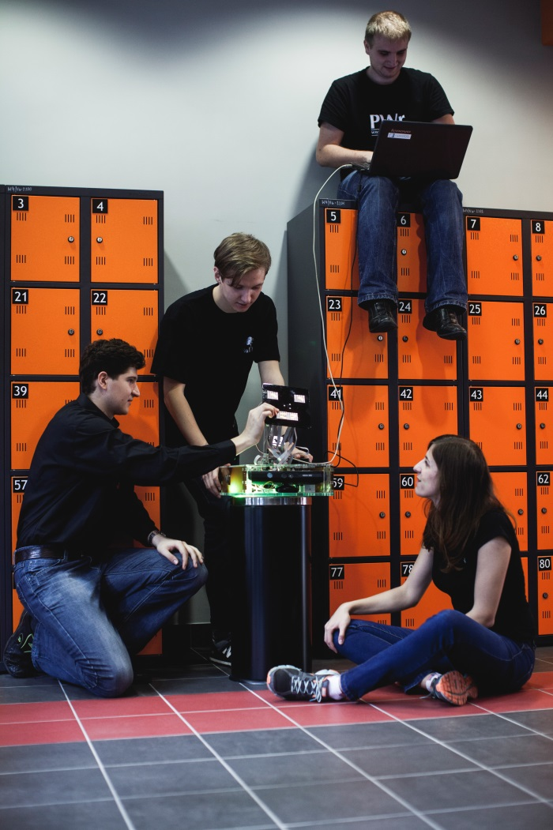
Student activities
More than 20 Student Activity Groups
SISK ( Informatics Systems and Computer Networks)
CHIP ( Microcontollers and Embedded Systems)
KoNaR ( Robotics)
MOS (Microsystems Oriented Society)
Activity Group of Polish Section
AUDIO ENGINEERING SOCIETY
Wireless Group
JEDI ( Just Everybody Drone it)

Slide 32
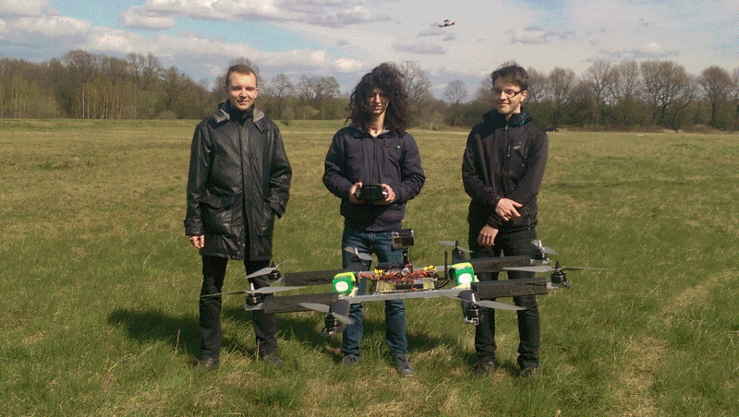
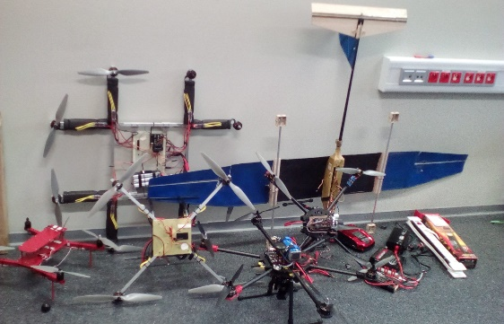
The International Micro Air Vehicle Competition (IMAV 2016 ) – JEDI ranked second place

Slide 33
International students
Wrocław University of Science and Technology offers a possibility of student exchange within:
ERASMUS + (EU countries and associated countries )
Erasmus Mundus for example:
Thelxinoe ( Australia, New Zeland)
Fellow Mundus ( South America )
Vulcanus Japan
Bilateral exchange agreement
All information are available on International Office website:
http://dwm.pwr.edu.pl/en/

Slide 34
Persons responsible at the faculty
First coordinator
Second coordinator
Assistant
Dr Dariusz CABAN
room 226
building C-3
dariusz.caban@pwr.wroc.pl
Responsibility area:
- informatics
- control
Piotr SŁOBODZIAN, prof. WrUST
room 808
building C-5
piotr.slobodzian@pwr.wroc.pl
Responsibility area:
- telecommunications
- electronics
Ms Anna KOLMAN
room 108
building C-5
and …. the International Office

Slide 35
Service to social issues was moved to the Department of Social Assistance for Students C-13, rooms: 1.01, 1.02, 1.03, 1.04 Decisions regarding scholarship and grants - Faculty Scholarship Committee The chairman of the Committee – dr inż. Zbigniew Zajda
Social Aid

Slide 36
Student’s Affairs Dean’s Office Kierownik Dziekanatu Wydziału Elektroniki

Slide 37
Stands in the Dean Office
a scheme, building C-1
4
Part-time studies
Teresa Jończyk
8
PhD studies, financial liabilities of students
Mgr inż. Agnieszka Chaszczewska
Department of Informatization
Moved to room 12, build.C-3
Manager of Dean’s Office
Agnieszka Gawryszuk
3
Internship, suplement
Piotr Wójcik
6
Alumnies, Graduates
Mgr inż. Beata Ocha
5
Full–time studies
mgr inż. Joanna Kawecka
6
Full–time studies
Józefa Żyto
7
Full–time studies
Paweł Mioduszewski
1
Archives
Krystyna Stefanik
Entrance (C-1 hall)

Slide 38
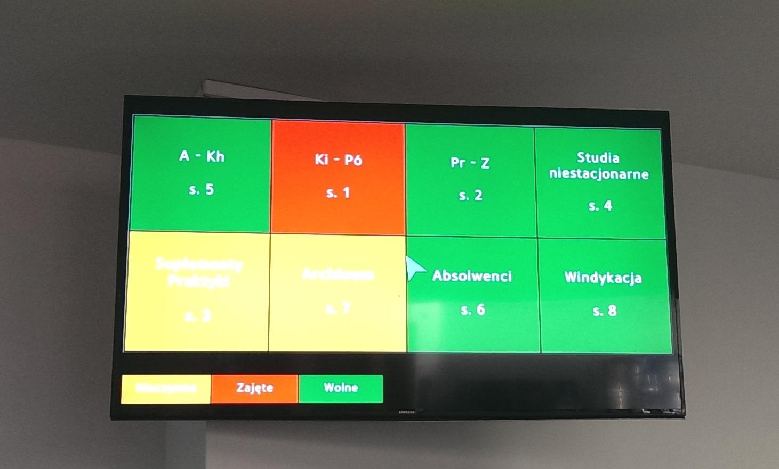
Info display – stand occupation

Slide 39
Office hours
Dean’s Office hours
Poniedziałek Monday | 08:00 - 12:00
Wtorek Tuesday | 08:00 - 12:00
Środa Wednesday | Nieczynne (closed)
Czwartek Thursday | 11:00 - 15:00
Piątek Friday | 08:00 - 12:00

Slide 40
Applications and Requests
Opening the issue in Edukacja.Cl and than generating and printing the application
Signing the application
Providing the application with the required attachments to Dean’s Office
Supplied application must be consistent with the document which had been generated in system
www.weka.pwr.edu.pl
Studenci → Do pobrania
(students -> downloads)

Slide 41
Who will do the matter for me?
Personally
or by a plenipotentiary
written notarized authorization
or by a personally authorized individual
authorization must be submitted in the presence of an employee of Dean’s Office

Slide 42
The official way of proceedings
Study issues / social issues
Relevant Vice-Dean
Dean
Vice - Rector
Organization issues
Manager of Dean’s Office
Dean
Vice-Rector
„The immediate superior of Faculty’s students is the Dean”
(Reg. govern. §1, sec.6)

Slide 43
Regulations Governing Higher Education Studies at WrUST
Effective from 1st October 2015
www.pwr.edu.pl
Studenci → Organizacja dydaktyki → Regulamin studiów

Slide 44
Electronic Student Record Book
Regulations Governing Higher Education Studies at WrUST
§ 10 sec.3, § 14 sec.14, § 15 sec.9
zaliczenie / exam
2 working days
The examiner enters a grade in the electronic student record book through the JSOS web page and send the statement to student
2 working days
A student accepts and confirms the grade in the system
A student does nothing
Student make a complaint
2 working days
2 working days
The grade is accepted automatically
Possible correction of the grade and final acceptance of the grade

Slide 45
E-mail’s savoir vivre ☺
Witam! / Hi! Szanowna Pani / Dear Madame
Szanowny Panie / Dear Sir
Szanowna Pani Dziekan / Dear Dean( of the Faculty of Electronics or surname)
Szanowny Panie Dziekanie / Dear Dean
Pozdrawiam / Bye Z poważaniem / Kind regards
Z wyrazami szacunku / Yours faithfully
Your signature is required!
E-mails should be sent using student’s e-mail box!
(the number of student)@student.pwr.edu.pl

Slide 46
Health insurance (ZUS)
The conditions of application for insurance by the University:
age > 26 years,
out of work (acceptable private agreement),
only student who study as Polish students – free of charge study
The rest of students is required to buy the insurance policy (NFZ is recommended by the Admission Office).
The holders of a Pole’s Card are obliged to sign a contract with NFZ and report to the Dean’s Office.
Alumni of Bachelors study were unregistered from a Health Insurance System after completion of the study.

Slide 47
Important information
Striking off the student from the register of students
Regulations Governing Higher Education Studies at WrUST- section 19
Enrollments: ? zapisy_w4@pwr.edu.pl
Enrolment has already started (?) !
Please make your enrolment as soon as possible!
Do not wait !

Slide 48
Documents you are receving
The act of oath taking document
The card of obligations – remember not to loose!
Certificate of study (2 copies)
The agreement of providing educational service (between the student and WrUST)

Slide 49
Electronic student card
The cost of the card is 17 zlotys (payed on an individual account)
A written statement is required if you want to use your old card (which had been issued a time ago)
Extension of validity is possible – please contact the Dean’s Office
Duplicate – the application is required – it costs 25,50 zlotys
The student card cannot be sold, handed over, etc.
Strictly forbidden under disciplinary penalty, according to Higher Education Regulations, art. 211 and consec., the act dated on 27.07.2005, as well as under criminal responsibility, according to the Penal Code, art. 274.

Slide 50
Document issuing
Please prepare your ID card in order to sign
and receive the agreement in a Dean’s Office!
Thank YOU !

